Slide 1

Grocery Store's Data MRA Project-Milestone 2

Slide 2

CONTENTS:
1. Executive Summary of the data Problem statement Data Summary & its Dictionary Assumptions about data 2. Exploratory Analysis & Insights Weekly, Monthly, Quarterly, Yearly Weekday Trends in Sales count Products counts & Year Wise top products Summary and Recommendations 3. Market Basket Analysis Market Basket Analysis Meaning MRA KNIME Workflow & Output Table 4. Associations Identified Association Rule Parameters MRA – values Association Rules Table 5. Recommendation Recommendation Summary

Slide 3

AGENDA
Executive Summary of the data
Exploratory Data Analysis
Market Basket Analysis
Associations Identified
Recommendation

Slide 4

EXECUTIVE SUMMARY
Problem statement
Executive Summary & Data Dictionary
Assumptions about data

Slide 5

PROBLEM STATEMENT
A grocery store has provided its transactional data for analysis. Your task is to uncover the most frequently purchased item combinations from customer orders. The store currently doesn't offer any combo deals. Based on your analysis, you are expected to recommend the most effective product combos and promotional offers to help boost sales and enhance customer experience.

Slide 6

DATA SUMMARY
Data: from 01-01-2018 to 26-02-2020
Objective: project involves conducting a thorough analysis of Point of Sale (POS) Data for providing recommendations through which a grocery store can increase its revenue by popular combo offers & discounts for customers.
Dataset: 20641 Rows, 3 columns,
Missing values : None
Duplicate values: 4730
The exploratory analysis and insights provide a clear understanding of the data and highlight the key trends and patterns in sales.
Market Basket Analysis using association rules was performed to identify the relationships between the products purchased by the customers.
This analysis helped to identify the products that are frequently purchased together, which can be used to create lucrative offers for the customers.

Slide 7



Data Dictionary
Feature | Description
Date | Date of product sold
Order_id | ID of the order
Product | Name of the product sold

Slide 8

Duplicate Values:
While it's usually recommended to remove duplicate rows to avoid skewing analysis, in this case, it's not appropriate. The dataset lacks a unique identifier, and rows are based on combinations of date, customer ID, and product purchased. Since multiple customers can buy the same product on the same date, removing duplicates could lead to loss of valid information. Hence, duplicate rows were retained in the dataset.

Slide 9

ASSUMPTIONS:
The data represents a list of items purchased at a grocery store on various dates.
Each entry in the data represents a single item purchased.
The first column in the data represents the date the item was purchased.
The second column represents the customer who made the purchase.
The third column represents the item purchased.
The same item can be purchased by multiple customers on different dates.
There is no information provided about the quantity or price of each item.
We have not dropped the duplicated values.

Slide 10
Exploratory Data Analysis
Weekly, Monthly, Quarterly, Yearly Weekday Trends in Sales count
Products counts & Year Wise top products
Summary and Recommendations

Slide 11
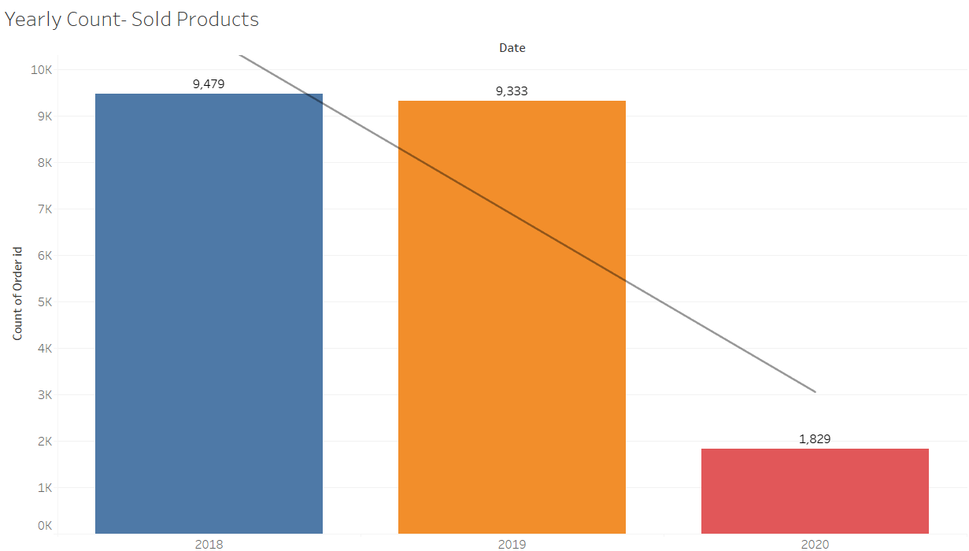
Yearly Count of Products Sold
As we have data till 26 feb 2020 that’s why the count of products sold in 2020 is low.

Slide 12
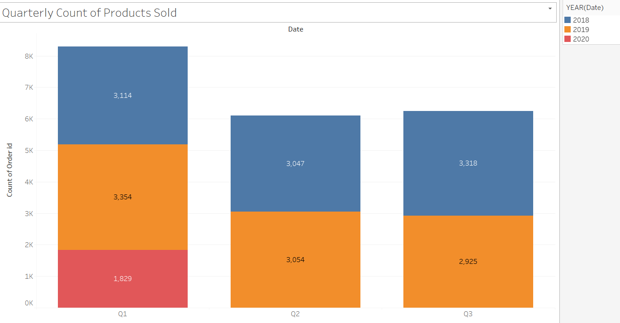
Quarterly Count of Products Sold
As we have data till 26 feb 2020 that’s why the count of products sold in Q1 is Hight.
In 2019 Q1 sales was highest
In 2018 Q3 sales was highest
Count of product sold in Q2 is aproxx same in 2019 and 2018.

Slide 13
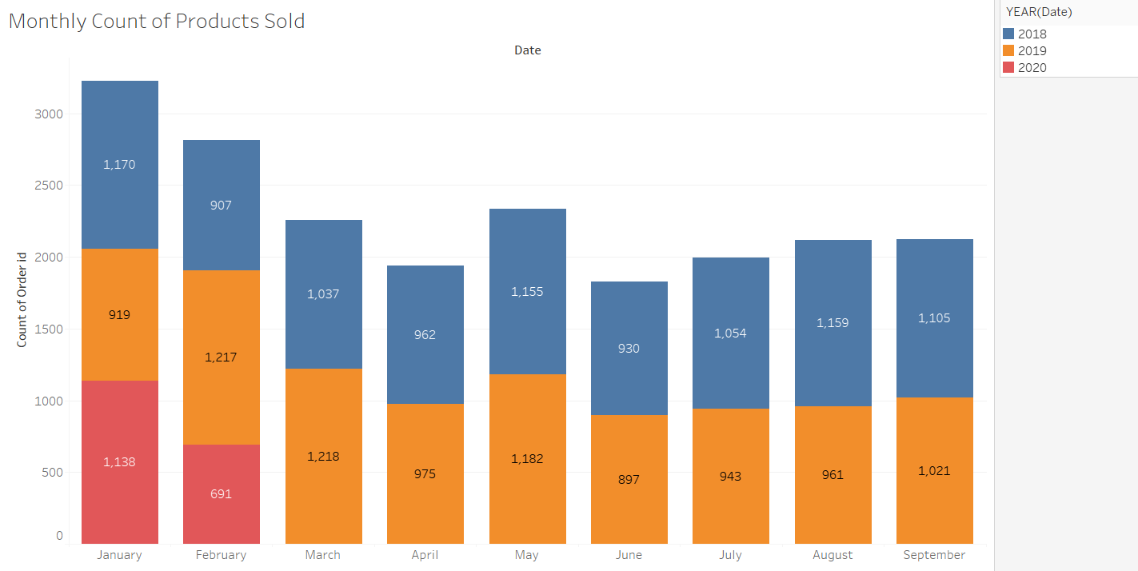
Monthly Count of Products Sold
In 2018 most of the products were sold in January and least were sold in February.
In 2019 most of the products were sold in March and least were sold in January.

Slide 14
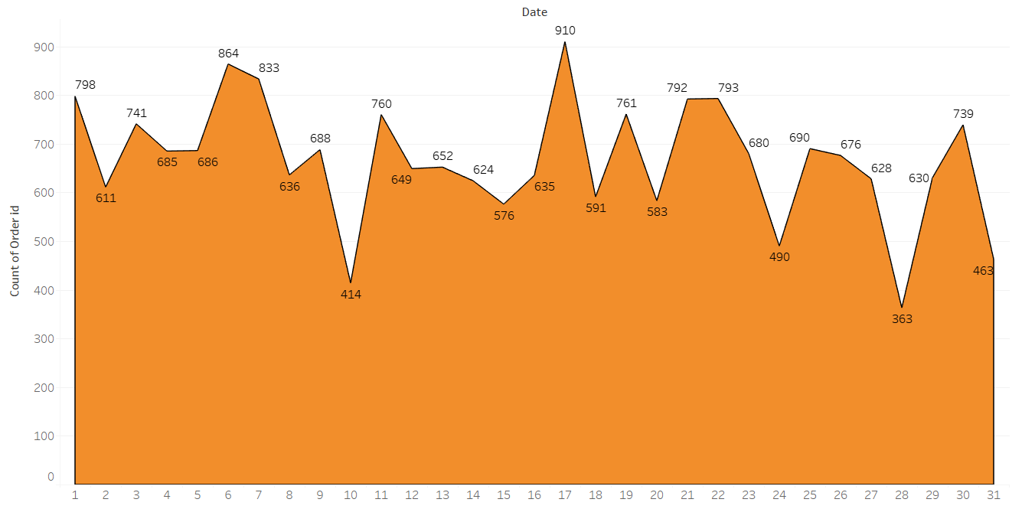
Day of the Month Count of Products Sold
Product sales fluctuate throughout the month, with the highest volume occurring around the 17th, and significant dips around the 10th and the end of the month

Slide 15
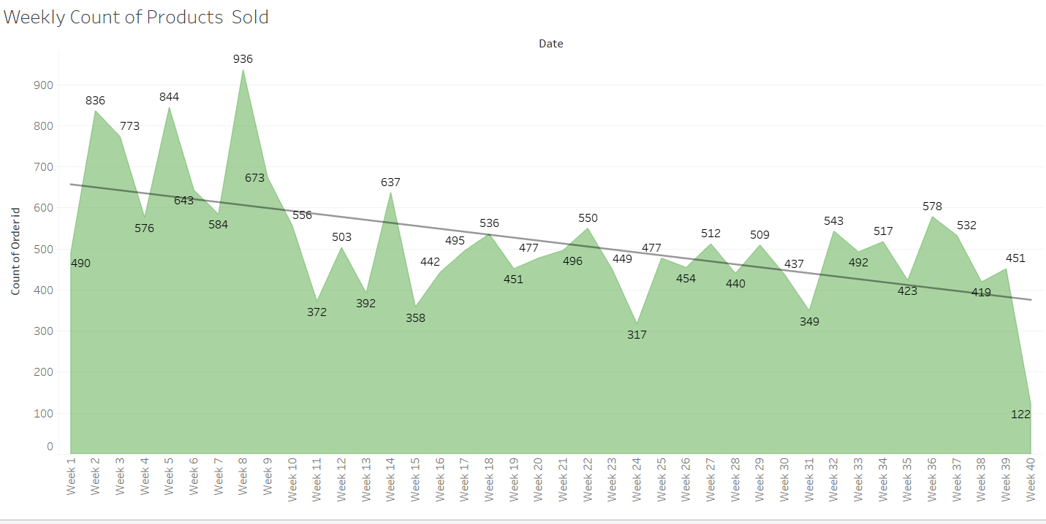
Weekly Count of Products Sold
Product sales generally decline over the weeks, with a peak in the first week and a significant drop by week 40.

Slide 16
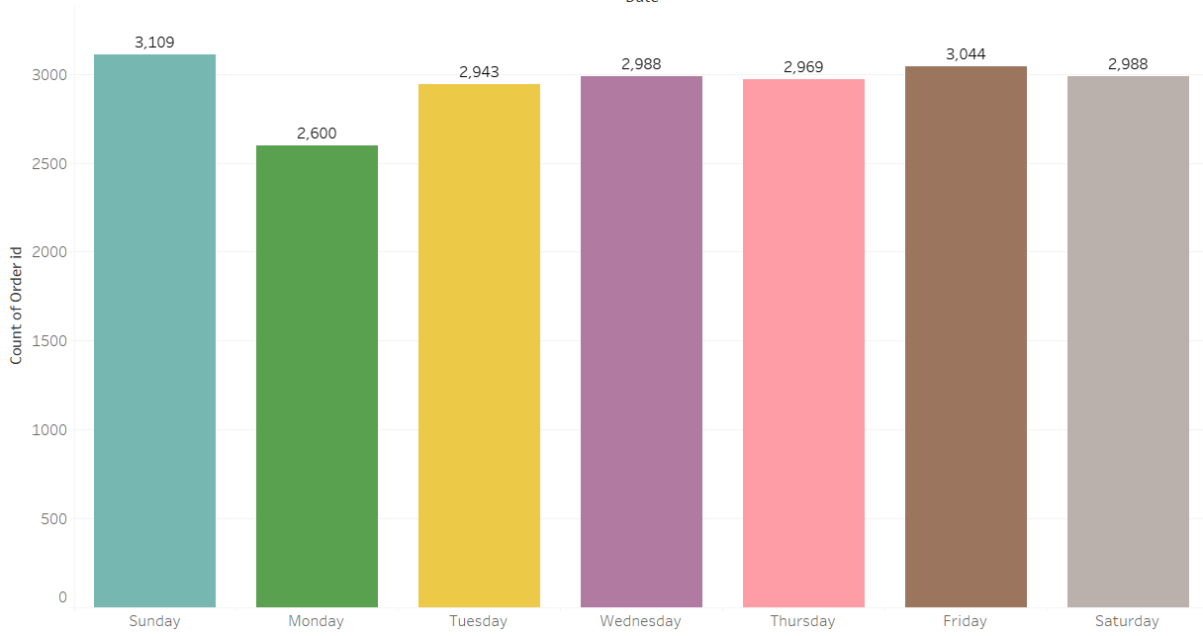
Weekday Count of Products Sold
Most of the products were sold on Sundays.
Least products were sold on Mondays.
On other days sales in consistent.

Slide 17
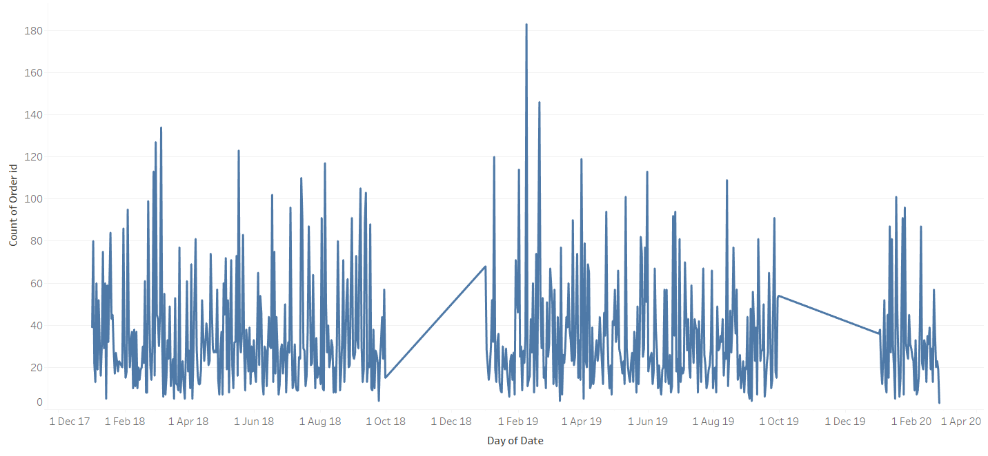
Daily Count of Sales
Daily sales fluctuate significantly with several peaks and troughs, showing no clear trend but indicating high variability

Slide 18
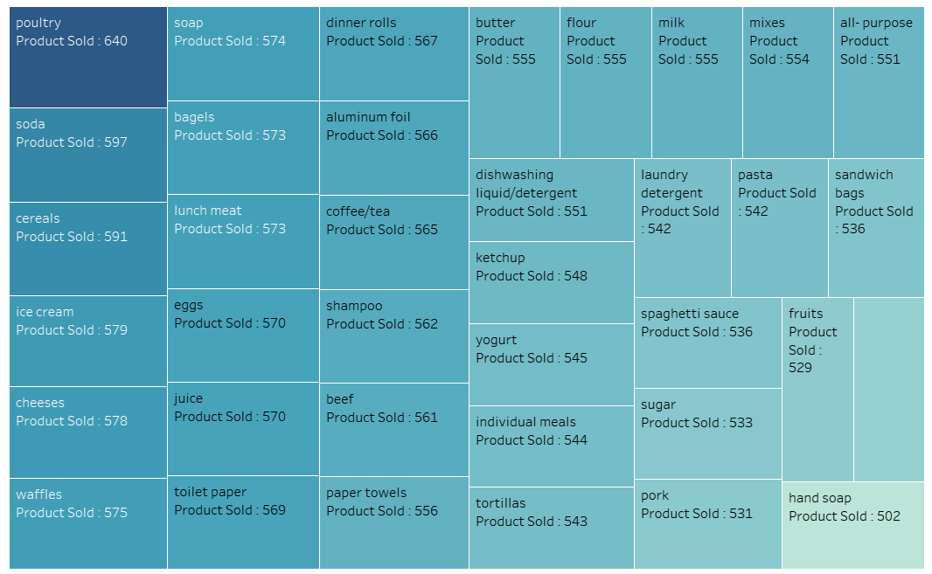
Count of Products Sold
Poultry has the highest sales volume, while "Hand Soap" has the lowest, with most products selling in a relatively narrow range between 500 and 600 units.

Slide 19
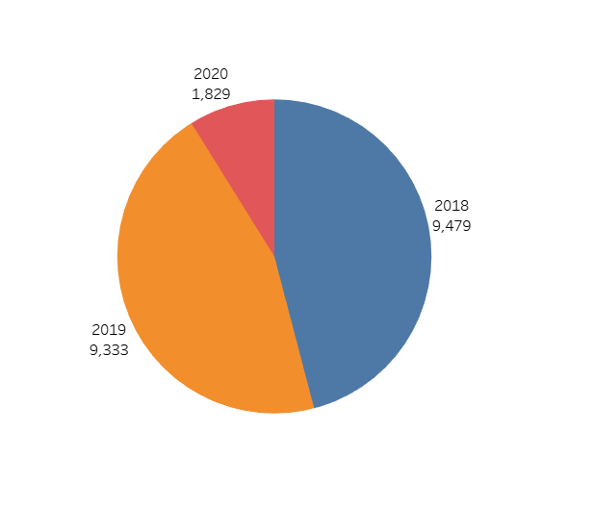
Count of Products Sold Yearly
In 2018, Most products were sold

Slide 20
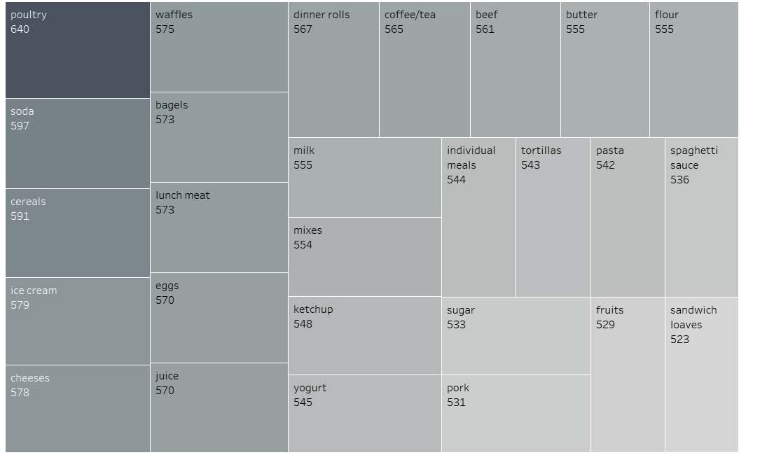
Count of Eatable Products Sold
There are total 28 products in this category.
Highest sold: poultry , Soda, cereals
Least sold : pork, fruits, sandwich loaves

Slide 21
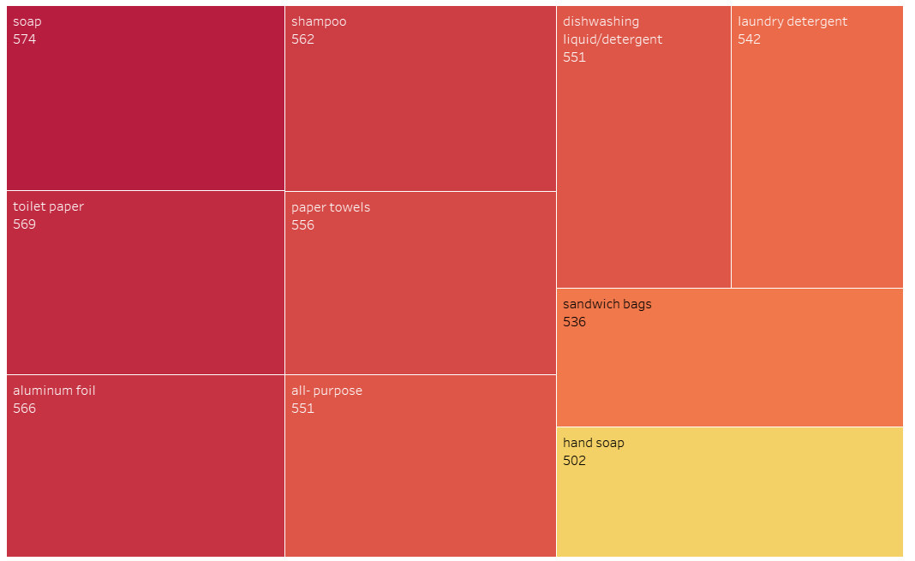
Count of Non-Eatable Products Sold
There are 9 products in this category.
Highest Sold Products : Soap, Toilet Paper.
Lowest Sold Products: Hand soap.

Slide 22
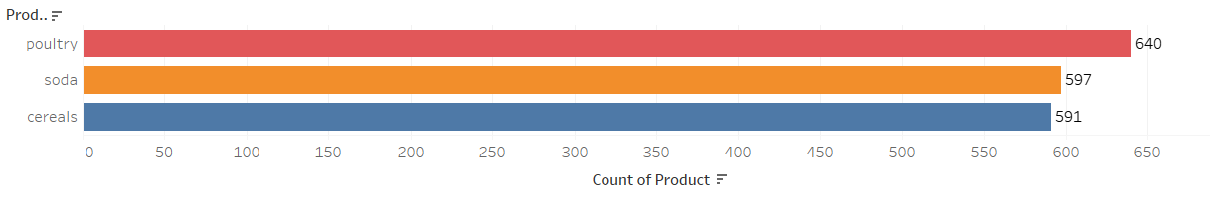
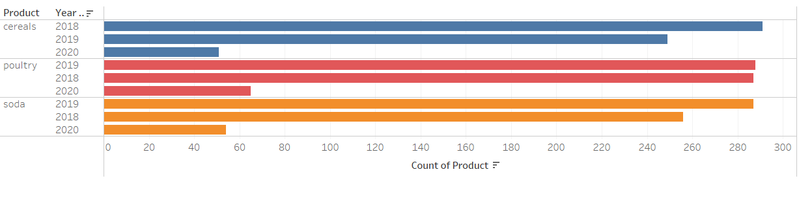
Top three products over the years
We can see poultry, cereals and soda are highly sold products over the years

Slide 23
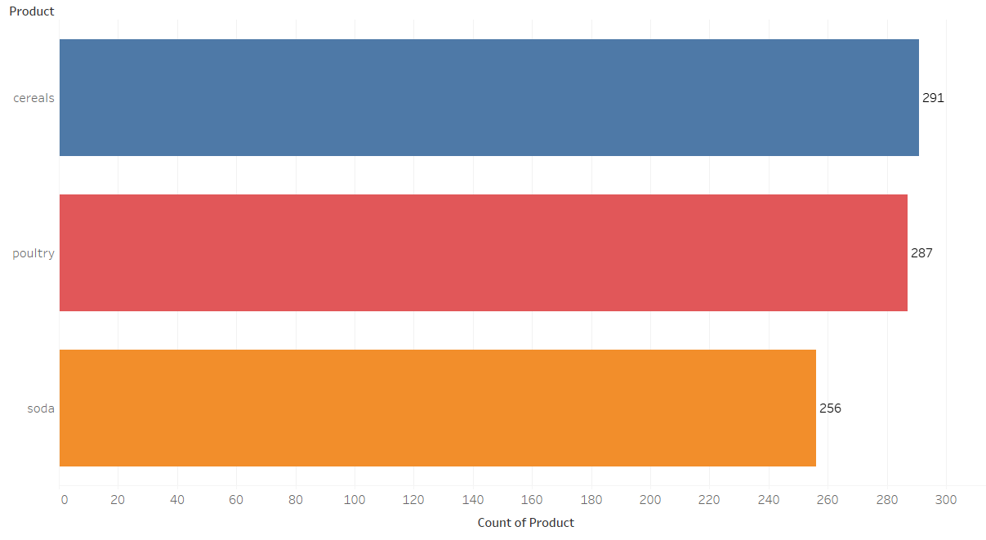
Count of Products sold in 2018
Cereals, Poultry and Soda are the top 3 Products sold in 2018

Slide 24
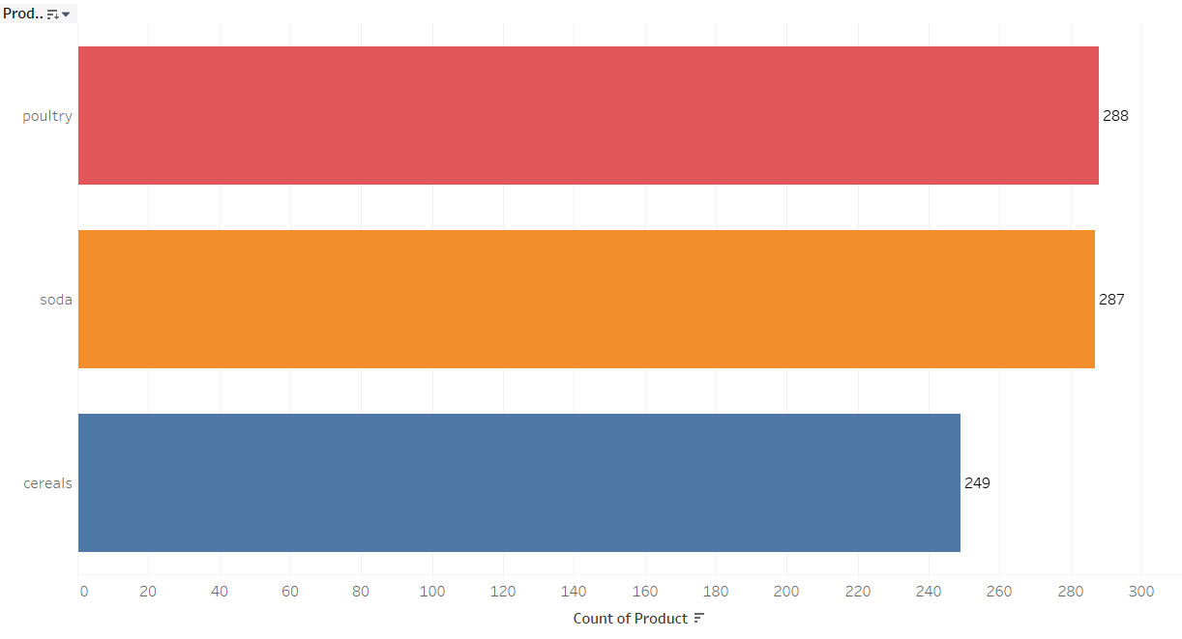
Count of Products sold in 2019
Poultry, Soda and Cereal are the top 3 Products sold in 2019

Slide 25
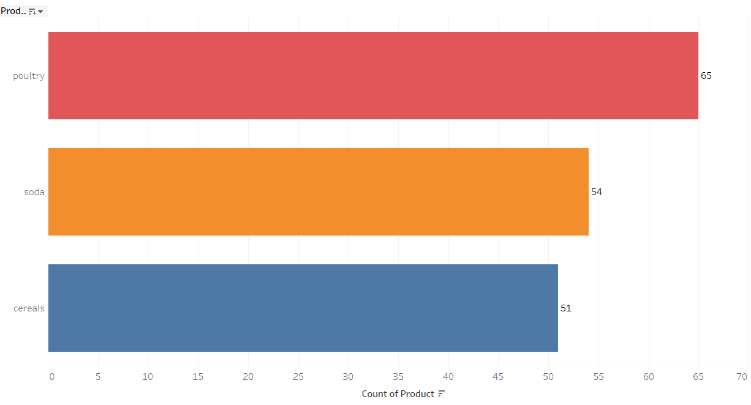
Count of Products sold in 2020 January and February
Top 3 products sold in 2020 January and February are dinner role, poultry and pork

Slide 26

SUMMARY
Top-selling products in 2018 and 2019 were Cereals, Poultry, and Soda.
For Jan-Feb 2020, the leading items were Dinner Rolls, Poultry, and Pork.
Overall, the consistently high-selling products across the years were Poultry, Cereals, and Soda.
In the non-edible category, Soap and Toilet Paper had the highest sales, while Hand Soap had the lowest.
Among edible items, Poultry, Soda, and Cereals topped the list, whereas Pork, Fruits, and Sandwich Loaves were least sold.
Sunday saw the highest product sales, while Monday had the lowest.
In 2018, January had the highest sales; February the lowest.
In 2019, the peak was in March, and the dip was in January.
The highest quarterly sales were in Q1 2019 and Q3 2018.
Product sales in Q2 were nearly the same for both 2018 and 2019.
2020 shows fewer sales, likely because the data only extends up to February 26th.

Slide 27

MARKET BASKET ANALYSIS
Market Basket Analysis Meaning​
MRA KNIME Workflow & Output Table

Slide 28
What is Market Basket Analysis
Definition: Market Basket Analysis is a statistical technique that analyzes customer purchase patterns to identify associations between different products. It helps businesses understand which products are frequently purchased together and how customers' buying habits affect sales.
Data: To conduct market basket analysis, businesses need transactional data that includes details such as customer ID, product ID, and transaction date. This data is then used to create a matrix that represents the relationships between different products.
Association Rules: Association rules are used to identify the strength of the relationship between different products. These rules are expressed in terms of support, confidence, and lift. Support refers to the frequency of co-occurrence of items in a transaction, while confidence measures the probability that if a customer buys one item, they will also buy another. Lift measures the degree of correlation between two items.
Applications: Market Basket Analysis is used in a variety of industries, including retail, e-commerce, and marketing. Retailers use this technique to optimize product placement and promotions. E-commerce companies use it to personalize product recommendations, and marketers use it to develop targeted advertising campaigns.
Benefits: Market Basket Analysis helps businesses increase revenue by identifying cross-selling opportunities and developing targeted promotions. It also helps improve customer satisfaction by providing personalized recommendations and improving the overall shopping experience

Slide 29
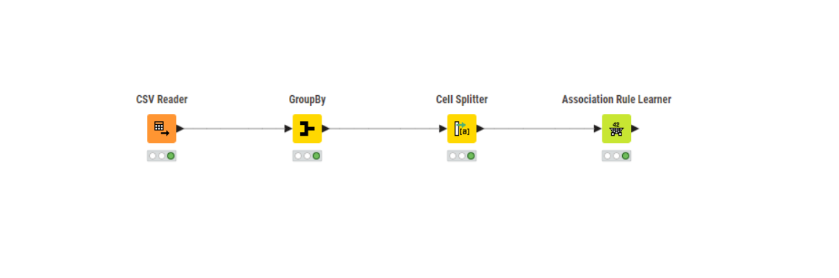
KNIME WORKFLOW

Slide 30
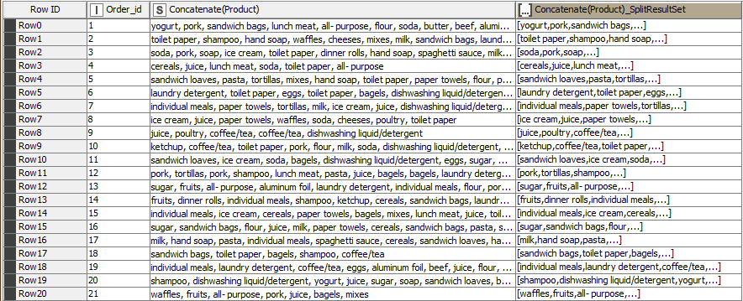
Output Table

Slide 31

ASSOCIATION IDENTIED

Slide 32
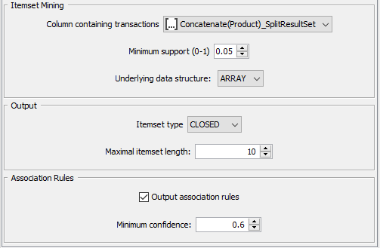
Association Rule Parameters
Support of Minimum: 0.05
Maximum Item Set Length : 10
Minimum Confidence Level:0.6

Slide 33
Market basket analysis, support, confidence, and lift values

Slide 34

In market basket analysis, support, confidence, and lift values are used to measure the strength of association between items in a transaction dataset.
Support: It is the probability of observing the items together in a transaction. It is calculated as the number of transactions that contain both items divided by the total number of transactions. It measures how frequent the itemset occurs in the dataset. High support indicates that the itemset is popular and should be considered for promotion or placement together.
Confidence: It is the conditional probability that a transaction containing one item also contains another item. It is calculated as the number of transactions containing both items divided by the number of transactions containing the first item. It measures the strength of the association between two items. High confidence indicates that the items are likely to be bought together, can be used to recommend or suggest items to customers.
Lift: It is the measure of how much more often two items occur together than expected if they were independent of each other. It is calculated as the support of the itemset divided by the product of the individual supports of the items. A lift value of 1 indicates that the items are independent, while a value greater than 1 indicates a positive association between the items. A lift value less than 1 indicates a negative association between the items. High lift indicates that the items have a strong association and can be used for cross-selling or bundling.

Slide 35
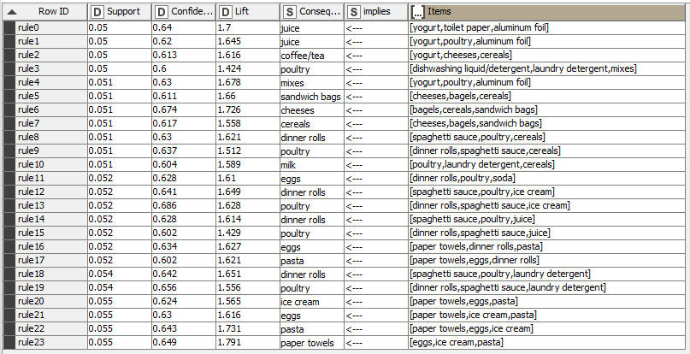
Association Rules
Association rules are a technique used to find relationships or associations between items in a large dataset. These rules are based on the concept of frequent item sets, which are sets of items that appear together frequently in a transactional dataset.
24 rules have been found with the dataset and set parameters.

Slide 36

RECOMMENDATIONS

Slide 37

RECOMMENDATIONS
Introduce a "Buy 2, Get 1 Free" offer on yogurt, poultry, and aluminum foil to boost bulk purchases.
Launch a combo deal with cereals, bagels, and sandwich bags at a special price to promote bundled buying.
Offer a discount on mixes when bought alongside yogurt, poultry, or aluminum foil.
Provide discounts on dinner rolls when purchased with spaghetti sauce or poultry.
Roll out a "Paper Products Bundle" including paper towels, toilet paper, and tissues at a reduced price.
These promotions aim to increase customer spending and offer better value. For maximum impact, they should be advertised through in-store displays, flyers, and social media channels to ensure customer awareness and engagement.

Slide 38
SUMMARY
The analysis revealed key product combinations frequently bought together by customers, offering valuable insights for optimizing product placement and promotional strategies.
Popular items include yogurt, poultry, aluminum foil, cheeses, cereals, and dinner rolls. Interestingly, some unexpected product pairings emerged—such as poultry with dishwashing liquid, laundry detergent, and mixes.
Introducing promotions like “Buy Two Get One Free” on these frequently paired products could encourage higher purchase volumes.
Additionally, placing complementary items near each other in-store can boost cross-selling opportunities.
In summary, this market basket analysis helps the store better understand customer preferences and make more data-driven decisions to enhance sales and customer satisfaction.

